Slide 1
Chapter 4
OS security

Slide 2
OS security
Hardware security
Process security
Memory protection
VAS protection

Slide 3
Security layers

Slide 4
Hardware security
The lowest and most basic level
Affects all other levels
Without minimal support, no security is possible
Hardware can also be used to accelerate functions and control execution of only some type of software (to be seen)

Slide 5
Hardware requirements for security
Define explicit processes and separate their domains. A domain is a set of resources that can be used in specific ways by processes to perform their work, i.e. a set of rights that give processes access to some protection objects. There are four ways to perform separation of domains: physically, temporally, cryptographically, and logically.
Establish initial domain. There must be an initial consistent state from which additional domains can be started and kept separated. Only special trusted programs should be able to invoke system initialization. Larger systems include a separate processor to perform initialization; these processors can be used to establish a secure initial domain.
Link users with domains. There must be an identifiable principal or responsible party; subjects associated with these principals perform resource requests. This is an application of the policy of accountability. Establishing these links is mostly done by software but the hardware provides a path between the user and the machine.
Control communication between domains. Crossing from one domain to another should be strictly controlled through special instructions or gate crossings. This implies the concept of protected entry points, forcing the calls to processes in other domains to go to specific entry points. This is discussed further in Section 4.4.
Detect and handle faults. Faults can be sources of security exposures. In particular, interrupt handlers should have their own execution domains

Slide 6
OS functions
Process Management-- handles creation and deletion of processes, communication and scheduling. Its security aspects include assignment of rights to new processes, secure communication between processes, and controlled execution environments for processes
Memory Management-- keeps track of which parts of memory are used by which processes, allocates and deallocates memory. For security purposes, this function must provide isolation of process areas and controlled sharing of other areas.
File Management-- handles creation and deletion of files and directories, file searches, and mapping files to secondary storage. The file manager must define and enforce authorizations or permissions to use the files
I/O Management-- provides interfaces to hardware device drivers, as well as handling mass memory management components including buffering, caching, and spooling. use.
Networking-- controls communication paths between two or more systems. .
User Interface--communicates between user and OS including command interpreters. This function must authenticate users when they log in to the system

Slide 7
OS functions

Slide 8
Basic OS policies
Isolation—a process must be protected from other processes.
Controlled sharing—processes must be able to share resources in a controlled way.

Slide 9
Trust Management
Trust
Trust is a particular level of the subjective probability with which an agent assesses that another agent will perform a particular action in a context that affects his actions
Reputation
Expectation about an entity’s behavior based on past behavior
May be used to determine trust

Slide 10
Role of Trust Management
Each entity (peer) must protect itself against threats
Trust Management can serve as a potential countermeasure
Trust relationships between peers help establish confidence
Two types of decentralized trust management systems
Credential and policy-based
Reputation-based

Slide 11
Trusted Computing Base(TCB)
The part of the system which we trust
Kernel: includes all security-related functions
Verification: possible only for relatively simple systems, and requires special languages and special operating systems
In practical systems we need to trust some part of the OS

Slide 12
Use of kernels
DBMS
DBMS Kernel
Sec. Kernel
OS
OS Kernel

Slide 13
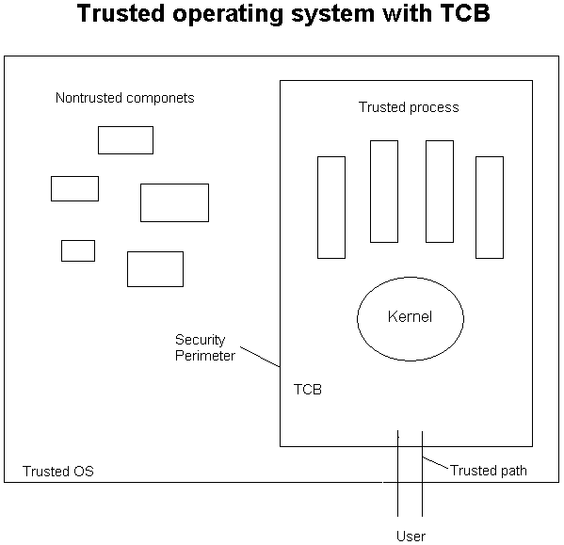

Slide 14
Processes
A process is a unit of execution (a program in execution)
A process is defined by its Process Control Block (PCB), a data structure containing its id, and references to its context.
A context includes a stack, pending interrupts, registers, temp data,…
A process should receive a separate address space for its execution.
A thread is a lightweight process (faster context switching than a process) and shares its address space with other threads. A thread includes a program counter, a register set, and a stack.
Because of its shared address space, an error or attack from another thread can corrupt its memory.
Most operating systems allow several threads to be bundled in one process; this protects the thread group as a whole from other processes.
User processes and threads can be created with special packages, e.g., Posix in Unix, or through the language.
The operating system defines kernel threads as units of concurrent execution.

Slide 15
Process interaction
kernel
ordersProcess
system
calls
messages
shippingProcess
Fulfilled Orders
kernel mode
user mode
Pending Orders
Bills
Customer List
Customers

Slide 16
Process communication
Process communication also has an effect on security. Systems that use explicit message passing have the possibility of checking each message to see if it complies with system policies.
A security feature that can be applied when calling another process is protected entry points. A process calling another process can only enter this process at pre-designed entry points. This prevents bypassing entry checks
The number and size of arguments in a gate crossing can also be controlled (this may protect against some types of buffer overflow attacks)

Slide 17
Execution states or modes
At least two modes of operation are needed to have any security.
Most hardware architectures use a supervisor and a user mode. In the user mode some instructions, called privileged instructions, cannot be executed directly. In supervisor mode all the instructions can be executed.
The state of a process is kept in a register called a Program Status Word (PSW).

Slide 19
Protection rings
Some architectures define in their hardware a set of rings (4 to 32) that correspond to domains of execution with hierarchical levels of trust. Rings are a generalization of the concept of mode of operation.
A domain includes all the resources that can be used by a process and in what way (read, write,…)
Crossing of rings is done through gates that check the rights of the crossing process. A process calling a segment in a higher ring must go through a gate.

Slide 21
Memory protection
In early machines memory areas were protected with locks and keys, an area of memory was assigned a lock value and a process was assigned a key that when matched gave it access to that area of memory. That approach was restrictive and inflexible, keys granted no access or full access, and some areas of memory were defined as read only. Locks were stored in registers assigned to fixed partitions.
The situation was improved by using pairs of base/limit registers which indicated the boundaries of the memory area allocated to processes. The two registers indicate from where the running process can fetch instructions and the area of memory it can access
The address calculation part of the execution sequence of a typical instruction would be: if (PC) > L trap [(PC) indicates the contents of the Program Counter relative to the base, L is the limit] ; else MAR ← B+(PC) (B is the base register, MAR is the Memory Address register).
This approach is more flexible in that the pair of registers can point anywhere in memory but still it can only define full access or no access.

Slide 23
Page protection
For memory allocation most systems use paging, segmentation, or a combination of both.
When paging is used, a process has a page table that indicates the units of memory (pages) allocated to it.
Page table entries can be used to describe the permitted type of access to pages, such as read, write, execute
Because pages do not correspond to logical units in a program this protection is rather imprecise. It is, however, the most commonly used approach, because of its simplicity and good performance.

Slide 24
Page adressing

Slide 25
Segmentation
A better approach for security is segmentation, where processes are given a descriptor segment that contains segment descriptors that indicate their type of access to a set of memory segments
Segments are variable-size units that correspond to logical program units, e.g., code, procedures, data.
Systems that use segmentation can apply a more accurate protection.
Two approaches to implement this idea are commonly used, capabilities and descriptors.

Slide 26
Descriptors
Descriptors are loaded when the process is loaded for execution.
Because the descriptors are used also for addressing they are handled by the memory allocation unit of the OS and we need to trust now that unit.
Descriptors and capabilities can be seen as embodiments of rows of the access matrix

Slide 27
9/28/2017
27

Slide 28
Capabilities
Capabilities are a generalization of base/limit register pairs that include the type of permitted access.
Capabilities are given to the process and its owner keeps them for subsequent use
Their security depends on having a special trusted process that assigns capabilities to processes and on the users inability to modify them. Usually hardware assistance is needed for these restrictions
Now we only need to trust the capability handler, so using caps is inherently more secure than other methods
9/28/2017
28

Slide 30
Controlled address space
Also called Execution domain or sandbox
Access is controlled through descriptors or capabilities
As a process executes it creates one or more Domains. Domains can be recursively composed (Composite pattern)
The descriptors used in the process’ domains are a subset of the Authorizations that the Subject has for some Protection Objects (defined by an instance of the Authorization pattern of Chapter 3).
ProtectionObject is a superclass of the abstract Resource class and ConcreteResource defines a specific resource.
Process requests go through a ReferenceMonitor that can check the domain descriptors for compliance.
Used in Java, Haiku, browsers, and others

Slide 31
Controlled Address Space (sandbox)

Slide 32
Virtual Address Space structure
One address space per process
Two address spaces per process (data and code)
One address space per user process, all of them shared with an address space for the OS
A single-level address space

Slide 34
File protection alternatives
Map files to a single-level virtual address space (VAS). Files are then protected by capabilities or descriptors. Requires a very large VAS
Have a special file authorization system. This is done in most commercial operating systems.

Slide 35
OS file authorization
MacOS X versions 10.3 ("Panther") and prior use POSIX-compliant permissions. Mac OS X, beginning with version 10.4 ("Tiger"), also support the use of NFSv4 ACLs. They still support "traditional Unix permissions" as used in previous versions of Mac OS X, and the Apple Mac OS X Server version 10.4+ File Services Administration Manual recommends using only traditional Unix permissions if possible. It also still supports the Mac OS Classic's "Protected" attribute.
Solaris ACL support depends on the filesystem being used; older UFS filesystem supports POSIX.1e ACLs, while ZFS supports only NFSv4 ACLs.
Linux supports POSIX.1e ACLs. There is experimental support for NFSv4 ACLs for ext3 filesystem.^{[4]}
FreeBSD supports POSIX.1e ACLs on UFS, and NFSv4 ACLs on UFS and ZFS.
IBM z/OS implements file security via RACF (Resource Access Control Facility)

Slide 36
Unix/Linux file control
Every user is given a unique identifier, UID. If a user creates a file, her UID is associated with the file and the user becomes its owner. Users are divided into groups and each group has a unique group identifier, GID.
A set of 12 bits (a file permission) defines how the file may be accessed by the owner, by the group to which the owner or process belongs, and by the rest of the users (world).
There is no way to specify access for specific users, i.e., a file permission is a restricted form of the access matrix.
A permission defines only three types of access for files: read, write, and execute (these are interpreted differently for directories). A permission is a four-digit octal number (three bits define the owner’s rights, three bits define group rights, three bits define everybody else’s rights) and can be set by a special instruction chmod. The permission includes also three bits that have the following purpose:
A setuid bit, that lets a process run with the id (and the rights) of the owner of the file (a type of amplification).
A setguid bit, that does the same with respect to group rights (the group of the creating process in System V or the directory group in BSD).
A sticky bit, that is used for memory management (to keep the program text in memory after the process completes execution). This bit here is an example of a violation of the “least-common mechanism” principle (See Chapter 2).

Slide 37
Effect of OS architecture on security
Monolithic or unstructured
Modular
Layered
Virtual machine OS
Microkernel
Most practical systems use a combination of these architectures; for example, a virtual machine operating system can be layered or can include a microkernel

Slide 38
Monolithic architectures
This approach was used in earlier operating systems and is rarely seen now
The operating system consists of a collection of procedures, where each procedure provides a specific set of services. When they need services, the user processes call operating system procedures, which in turn may call other OS procedures.
In its basic form there is no information hiding; every procedure interface is visible to all the other procedures
Some structure is possible by grouping the procedures into service and utility procedures, where the utility procedures are in a lower level than the service procedures
The open interfaces provide more possibilities of attack and this architecture, while simple, is not secure. All the processes run in supervisor mode, which also facilitates attacks.
The lack of modularity doesn’t allow good use of concurrency, which may affect performance.

Slide 39
Layered architectures
In this approach the operating system is a hierarchy of layers of abstraction, where each layer presents an interface to the higher layers and hides the details of the lower layers
The lowest level layer is the kernel, which normally includes process creation, destruction, communication, and scheduling, memory management, and some basic I/O. The middle layer(s) includes file management and higher-level I/O. The highest level includes editors, user interfaces, mail systems, and other utilities (usually called system services).
This provides clearly defined interfaces between each section of the operating system and between user applications and the OS functions
Layer i uses services of a lower layer i-1 and does not know the existence of a higher layer i+1.
Variations of this structure are used in Unix, Linux, and Windows.
Its advantages include: Lower levels can be changed without affecting higher layers (we can add or remove security functions as needed). The use of clearly defined interfaces between each OS layer and the user applications can improve security. In addition, the fact that layers hide implementation aspects is useful for security in that possible attackers cannot exploit lower level details.
All this comes at the cost of some performance overhead because of the need for extra calls to go across the layers.

Slide 40
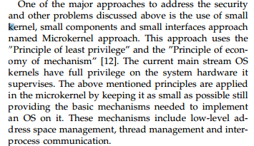
Microkernels

Slide 41
The Microkernel pattern (www.vico.org)
"The Microkernel architectural pattern applies to software systems that must be able to adapt to changing system requirements. It separates a minimal functional core from extended functionality and customer-specific parts. The microkernel also serves as a socket for plugging in these extensions and coordinating their collaboration." (Buschmann, F., R. Meunier, H. Rohnert, P. Sommerlad, and M. Stal. Pattern-Oriented Software Architecture: A System Of Patterns. West Sussex, England: John Wiley & Sons Ltd., 1996)
The microkernel includes functionality that enables other components running in separate processes to communicate with each other. It is also responsible for maintaining system-wide resources such as files or processes. In addition, it provides interfaces that enable other components to access its functionality.
It uses an Adapter pattern to let clients interface with its functions

Slide 42
Microkernel-based architectures
A microkernel includes mostly communication functions and a set of some fundamental services, typically functions such as process creation/deletion, process communication
All other non-essential functions are implemented as part of internal or external servers.
The client interfaces with the kernel through an Adapter (interface transformer). This routes the service request to the either the microkernel or to an external server.
The microkernel class is used mostly to establish communication and to perform very basic functions. Additional functionality is decoupled into internal servers. External servers implement their view of the microkernel as seen through its interfaces.
This decoupling makes the microkernel reusable and the operating system becomes highly extensible, we just need to add more internal or external servers.
This approach is a type of client/server system where the microkernel provides a common facility between client programs and services.
The microkernel is effectively a Reference Monitor

Slide 43
Microkernel
9/28/2017
43

Slide 44
Reducing kernel mode execution
If only a few critical functions run in kernel mode security and reliability improve
Hypervisors and microvisors run in kernel mode but all other programs run in user mode
It also improves performance
Can act as a Reference Monitor (see cloud security chapter)

Slide 45
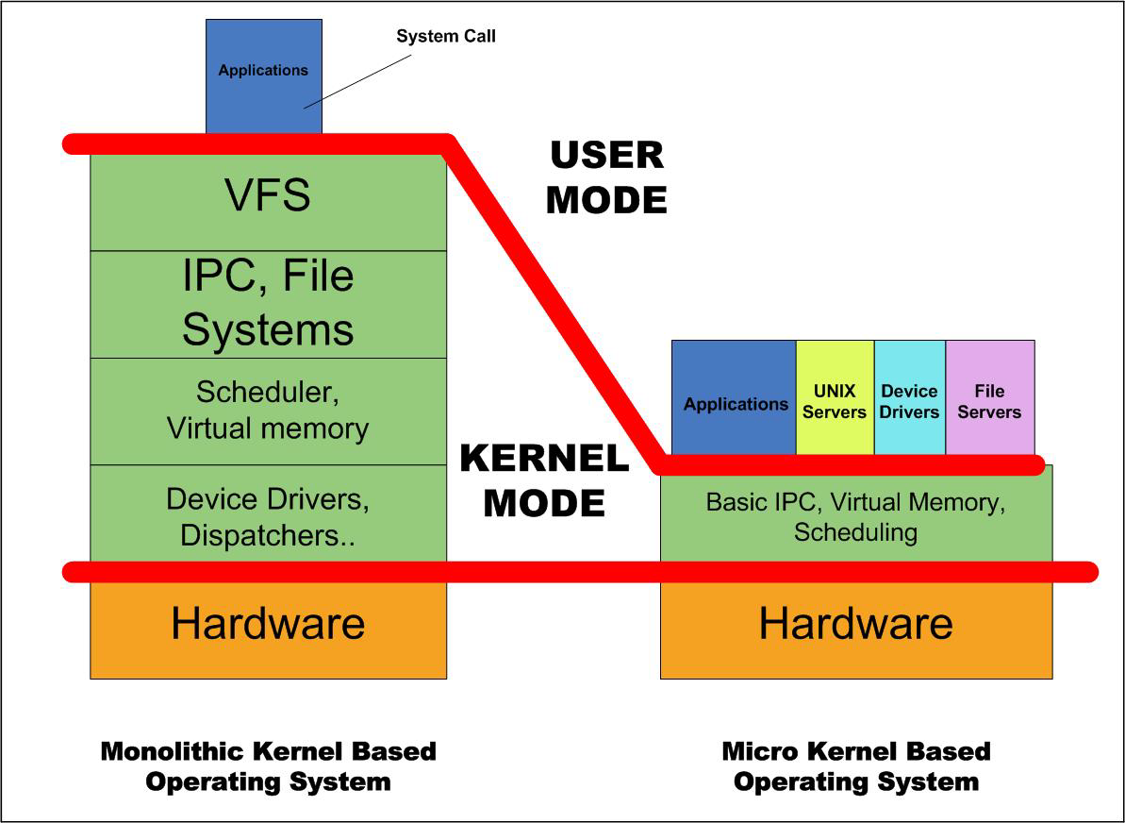

Slide 46
Virtual machine (VM) operating system
The idea here is to apply multiprogramming at the hardware level
Each VM runs in a virtual copy of the hardware implemented using a Virtual Machine Monitor (VMM), that acts as a specialized kernel for the complete system and is the only one with access to the real hardware
The VMM creates multiple replicas (virtual machines) of an instruction set architecture on one real system and allows one executing environment to run different operating systems
The VMM keeps tables describing the specific characteristics of the operating systems that run in the virtual machines so it can interpret system calls
Privileged instructions in the VMs are intercepted by the VMM, which interprets them according to the operating system running in the corresponding VM
Their value for security is based on their isolation properties. Microkernels can be used to implement VMMs.

Slide 47
Forces of VM OS
Each operating system needs to have access to a complete set of hardware features to support its execution.
Each OS has its own set of machine dependent features, e.g., interrupt handlers. In other words, each operating system uses the hardware in different ways.
When an OS crashes or it is penetrated by a hacker, the effects of this situation should not propagate to other OSs in the same hardware.
There should be no way for a malicious user in a VM to get access to the data or functions of another VM.

Slide 48
Virtual machines

Slide 49
9/28/2017
49

Slide 50
UC: Execute a system call

Slide 51
Security advantages of VMs
The VMM intercepts and checks all system calls. The VMM is in effect a Reference Monitor and provides total mediation on the use of the hardware. This can provide a strong isolation between virtual machines .
The VMM is small and simple and can be checked for security (not quite true for cloud systems)
There is a well-defined interface between the VMM and the virtual machines.
It is possible to move operating system security mechanisms, e.g. intrusion detection, outside the operating system to protect them from attacks
It is possible to monitor and control the network connections of the virtual machines to assure that they are protected and not malicious. The VMs can also be authenticated to the network
Isolating the software stacks of applications in separate machines simplifies reasoning about their security because they are free from interference from other applications
Each environment (VM) does not know about the other VM(s), this helps prevent cross-VM attacks.

Slide 52
Liabilities
All the VMs are treated equally. If one needs different categories of VMs it is necessary to build specialized versions
Extra overhead in use of privileged instructions.
It is rather complex to let VMs communicate with each other (if this is needed).
Security attacks are possible (to be seen) because of implementation additions

Slide 53
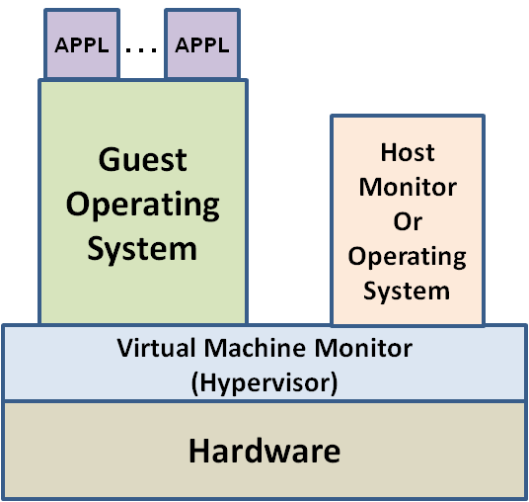
History of Virtual Machine Technology
Virtual Machine technology developed 5 decades ago
IBM 7044 -- First Virtual Machine (VM) capable system
Announced in 1961 Designed to run both Multiple OS instances
IBM 360 Model 67 – First True VM Hardware Platform
Announced in 1966
Classical privileged instruction trap & emulate
Utilized VMM Technology – CP/67
Important paper published by G. Popek & R. Goldberg in 1974
“Formal Requirements for Virtualizable Third Generation Architectures”
Fidelity – Software on the VMM executes identically to its execution on hardware, barring timing effects.
Performance – An overwhelming majority of guest instructions are executed by the hardware
with out the intervention of the VMM
Safety – The VMM manages all hardware resources
Technology began to disappear in the mid 1970’s
Inexpensive minicomputers and microcomputers
Primarily used for operating system testing
Re-immerged in the late 1990’s
Emulation for legacy systems
Better Server Hardware Utilization
Re-Tasked in the 2000’s -- Principal technology for Cloud Computing

Slide 54
Patterns for operating systems security
Controlled process creation
Controlled object creation
Authentication
Controlled object access (reference monitor)
File access control
Controlled execution environment

Slide 55
Patterns for secure process management
Secure Process
creation
lightweight
execution
create
Objects
Controlled
Process Creator
Secure Thread
Controlled
Object Factory
enforce
Rights
Controlled
Object Monitor
Reference Monitor
define
Rights
check
Rights
define
Rights
Authorizer

Slide 56
Secure Process/Thread
How do we make sure that a process does not interfere with other processes or misuse shared resources?
A process is a program in execution, a secure process is also a unit of execution isolation as well as a holder of rights to access resources.
A secure process has a separate virtual address space and a set of rights to access resources.
A thread is a lightweight process. A variant, called secure thread is a thread with controlled access to resources.

Slide 57
Secure process

Slide 58
Controlled-Process Creator
How to define the rights to be given to a new process? Define their rights as part of their creation.
Prevents child process from automatically inheriting rights of parent process, basic step in buffer overflow attack

Slide 59
Controlled-Process Creator

Slide 60
Process creation dynamics

Slide 61
The Controlled Execution Environment pattern
Intent: To control access to all operating system resources by processes, based on user, group, or role authorizations.
Context: A process executes on behalf of a user or role (a subject). A process must have access rights to use these resources during execution. The set of access rights given to a process define its execution domain. Processes must be able to share resources in a controlled way. The rights of the process are derived from the rights of its invoker.

Slide 62
Process/domain rights

Slide 63
Entering a domain

Slide 64
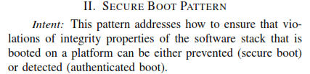

Slide 65
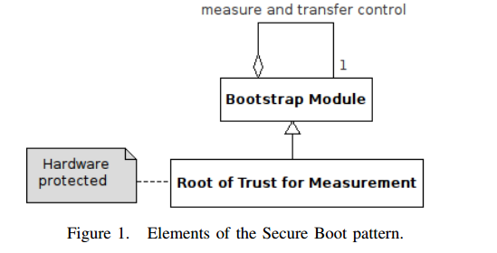
Secure Boot

Slide 66
Commercial OSs
There are relatively few types of operating systems used in commercial systems, for small and medium systems most of them are variants of Windows or Unix.
Servers and mainframes add a few varieties such as z/OS, while portable devices have a larger variety but still only a few are used (Windows, Symbian, Android, Mac, and Linux).
Comparisons of Unix and Windows security conclude that neither is clearly superior in this respect. Windows 2000 introduced several improvements over Windows NT . Based on actual incidents the Microsoft operating systems appear weak in spite of their relatively good security architecture; it seems that most of the problems are due to poor implementation and unnecessary complexity (Windows 2000 has over 40 millions lines of code).
The newer versions are considerable better because they adopted a Secure Development Cycle.

Slide 67
Authorization in OSs
Some systems, typically mainframes, use a separate authorization service that contains ACLs that define rules to control access to resources (files, data sets, programs, workstations).
When a process requests access to a resource, the resource manager invokes the authorization service to decide access. The advantage of this approach is that it is possible to change the authorization structure without affecting the rest of the operating system. Its disadvantage is some extra overhead.
An example of this approach is the z/OS of IBM, which uses the Resource Access Control Facility (RACF) to evaluate access [Gur01]. In other systems, e.g. Windows, the authorization system is integrated with the rest of the functions.

Slide 68
UNIX AFS Access Control Lists (ACLs)
Files on the central AFS fileservers all have the traditional Unix permissions but they are also controlled by Access Control Lists (ACL) which take precedence.
They provide access levels more flexible than the user/group/other attribute bits, but they work on the level of complete directories, not files. The command to set and list ACLs is fs.

Slide 69
Windows
Windows has a more elaborate access control structure and allows more types of access to files than Unix [Hya]. Its subjects are users, groups, and other computers and have unique identities. After a subject has been authenticated the system keeps an access token that contains information about the subject rights in the form of security attributes. There is also a mechanism similar to setuid in Unix, the impersonation token, where a subject can use another subject’s access rights. File rights include:
read access to a file that allows reading the data in the file and execution of a file,
no-access right, used for negative authorizations,
change access that allows file modification and deletion,
full control access, that allows ability to modify file permissions and to transfer ownership of a file, i.e., this is an administrative right.
As indicated earlier, Windows uses objects as units of resource access. An object includes a Security Descriptor that contains [Cal00]:
The Owner Security Identifier (SID), which can be a user, a group, or a computer. These are the subjects, called ‘principals’ by this sytem (and by several others).
The group SID.
A DACL (discretionary access control list), indicating which SIDs can access the object and how.
A SACL , System access Control List, used for auditing.

Slide 70
Windows NT and later
It uses objects as units of resource access
An object includes a security descriptor that contains the Owner SID, group SID, DACL (discretionary access), and SACL (used for auditing).
Four levels of administrative privileges: standard, administrator, guest, and operator.

Slide 71
Why Windows 10 is the most secure Windows ever http://www.networkworld.com/article/2984763/security/why-windows-10-is-the-most-secure-windows-ever.html?phint=newt%3Dnetworkworld_security_alert&phint=idg_eid%3Dc30d380502694c47d2c45cb7576fbd6b#tk.NWWNLE_nlt_security_2015-09-18
Device Guard relies on Windows 10’s virtualization-based security to allow only trusted applications to run on devices. Credential Guard protects corporate identities by isolating them in a hardware-based virtual environment. Microsoft isolates critical Windows services in the virtual machine to block attackers from tampering with the kernel and other sensitive processes. The new features rely on the same hypervisor technology already used by Hyper-V. Using hardware-based virtualization to extend whitelisting and protecting credentials was a “brilliant move”
Device Guard relies on both hardware and software to lock down the machine so that it can run only trusted applications. Applications must have a valid cryptographic signature from specific software vendors

Slide 72
Windows 10
Credential Guard stores domain credentials within a virtual container, away from the kernel and user mode operating system. This way, even if the machine is compromised, the credentials are not available to the attacker
Advanced persistent attacks rely on the ability to steal domain and user credentials to move around the network and access other computers. Typically, when users log into a computer, their hashed credentials are stored in the operating system’s memory. Previous versions of Windows stored credentials in the Local Security Authority, and the operating system accessed the information using remote procedure calls. Malware or attackers lurking on the network were able to steal these hashed credentials and use them in pass-the-hash attacks.
By isolating those credentials in a virtual container, Credential Guard prevents attackers from stealing the hash, restricting their ability to move around the network.

Slide 73
Security features in Mac OS X Yosemite (Oct. 2014) https://business.kaspersky.com/security-features-in-mac-os-x-yosemite/2798/
Mac OS X Yosemite (10.10) has arrived, and it’s time to look at what it’s going to offer us from the security point of view. Apple has actually set up a special page dedicated to security for Mac OS X with lengthy text – there’s a lot of it, but it’s comprehensible and rather easy to read. However, it doesn’t say a lot about what features are new.
Gatekeeper checks whether the app downloaded from other places rather than Mac App Store has the proper Developer ID. If it does not, it won’t launch, unless setting are changed.
FileVault 2 encrypts the entire drive on Mac, protecting the data with XTS-AES 128 encryption. Apple says that initial encryption is fast and unobtrusive.
The Safari Browser is equipped with Password Generator that creates strong passwords for your online accounts.

Slide 74
Mac OS 10.10 security II (by Yuri Ilyn)
It has the App Sandbox, a feature introduced in Mac OS X Lion 10.7. OS X delivers sandboxing protection in Safari by sandboxing the built-in PDF viewer and plug-ins such as Adobe Flash Player, Silverlight, QuickTime, and Oracle Java – exactly the software that is among the most vulnerable and exploited.
But OS X also sandboxes apps like the Mac App Store, Messages, Calendar, Contacts, Dictionary, Font Book, Photo Booth, Quick Look Previews, Notes, Reminders, Game Center, Mail, and FaceTime, so that nothing potentially malicious creeps in.
Here we also have run time protection at the core level: built into the processor XD (execute disable) feature that “creates a strong wall between memory used for data and memory used for executable instructions”. According to Apple’s description, this protects against malware that attempts to trick the Mac into treating data the same way it treats a program in order to compromise your system.
OS El Capitan is coming Sept. 30

Slide 75
Android architecture
Extended Application
…
…
Applications
Reference Monitor
Component Framework
JVM
Middleware
Policy Set
Linux OS

Slide 76
Symbian
Symbian Os is a hard RTOS
Symbian OS is an open system and is based on a micro kernel architecture which implements full multitasking and multithreading
The micro kernel uses client/server session based IPC in which servers mediate access to shared resources and services, and the kernel deals with memory allocations and IPCs
System services such as telephony, networking middleware and application engines all run in their own processes
Symbian OS v9.1 provides a proactive defense mechanism against malware. The platform security infrastructure uses a capability-based model, which ensures that sensitive operations (for example modifying user data, making calls, using network connections) can only be accessed by applications, which have been certified by an appropriate signing authority
Data caging is a new feature provided by the Symbian OS v9, which allows applications to have their own private data partition. This allows for applications to guarantee a secure data store. This can be used for e-commerce, location applications and others.

Slide 77
Symbian layered microkernel

Slide 78
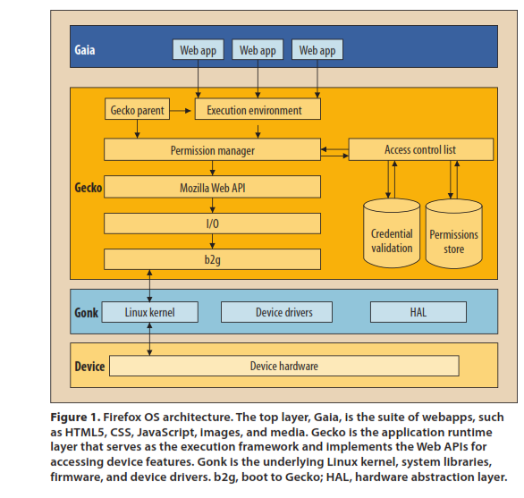
Firefox OS

Slide 79
Patterns in Firefox OS
Layers
Controlled VAS (sandbox)
Digital Signature
Controlled Process Creator
Multilevel Access Control
Authorizer (ACL)
Whitelisting
Credential

Slide 80
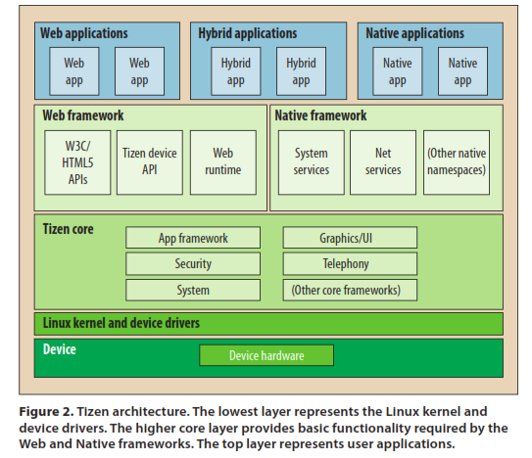
Tizen OS

Slide 81
Patterns in Tizen OS
Layers
Controlled VAS (Sandbox)
Multilevel Access Control (Mandatory)
Digital Signature

Slide 82
OS attacks
Remote login weaknesses
Password guessing
Bypass file permissions
Scavenge memory
Buffer overflow attacks
Denial of service attacks (resource hogging)

Slide 83
Example of attack
xterm race condition
A user request for a file is checked and found correct
Before the file is open the user changes the file link to another file
Example of Time of Check to Time of Use (TOCTTOU) problem

Slide 84
The Internet worm of 1968
Guessed and tried passwords with the use of a dictionary
Exploited bugs in the finger and sendmail programs, including buffer overflow.
Took advantage of the fact that some systems specify trusted computers from which remote logins are accepted without checking passwords.
Used encryption and other ways to hide its existence (a polymorphic virus).

Slide 85
Typical Weaknesses
Both Unix and Windows use passwords for authentication. Unix keeps passwords encrypted but the password file is readable by all users. This allows a user to make a copy and use dictionaries and parallel processing to guess passwords.
Process protection is based mainly on the user/supervisor mode separation and kernel processes are not protected against each other.
Even if hardware architectures offer further protection, e.g., descriptors and rings, most commercial OSs do not use them in an effort to get more performance

Slide 86
Weaknesses II
The concept of superuser, an almighty user, typically the systems administrator, is a poor security decision.
Inheritance of rights in forked processes is another flaw commonly exploited in attacks. If an attacker tricks a program in superuser mode to execute a Trojan Horse, this inherits the rights of that program and runs in superuser mode
Transfer of rights between processes—In Unix every user has a unique id, UID. If a bit in a file permission (setuid) for a file containing an executable program is turned on, the program executing that program acquires the rights of the file owner. Windows has an impersonation token, that has a similar effect. This violates the principle of accountability.

Slide 87
Weaknesses III
Lack of conceptual model. The file permission structure doesn’t follow the access matrix or any other security model. The interpretation of rights for directories makes things even more muddled
Directory problems. An attacker can place his own file in the path of a writable directory and maybe get higher privileges when the file is invoked.
Most systems lack the concept of a trusted path. A trusted path is a user connection to a part of the system that provides secure login, authentication, and rights.
Some systems do not have auditing facilities or the audit log is within reach of the superuser (and could be changed by a hacker acting as a superuser).

Slide 88
Weaknesses IV
Complex, poorly designed, and poorly tested utilities.
Some flaws come from implementation languages, e.g., buffer overflow. Buffer overflow occurs when a variable in a procedure is filled with more values that it can hold. The overflow can overwrite the return address and if the hacker put her code there her program could get superuser mode (to be seen )
Finally, configuration of these systems is complex and administrators make many mistakes. There are many demo programs and rarely used utilities which can be exploited by hackers.

Slide 89
OS defenses
Memory protection (supported by hardware)
File protection
Access control for I/O devices
Capabilities and descriptors are effective mechanisms
Firewalls to protect access to the system
IDS (Intrusion Detection System)
Authentication (part of login)
Notes:
Memory can be protected with hardware assistance: descriptors and capabilities are effective ways
Files can be protected in the file system or through the memory system
I/O devices may have special access controls
Good processor support is required to apply controls, some RISC processors don’t do well in this respect
Capabilities are the most secure approach, require minimal trust. There are no commercial cap computers now (poor performance). Descriptors are next in security value (used in Intel processosrs and in IBM S/6000).

Slide 90
Hardened OSs
IBM’s AIX (Advanced Interactive eXecutive)—Based on Unix. It implements a TCB and a Trusted Comm. Path. Its TCB includes the kernel and some Trusted Processes.
Supports a DAC. Instead of read/write/execute rights, AIX defines an Abstract Data Type (class), with higher-level operations, appropriate for the type of object such as copy, save, query, and set. These accesses define an access matrix implemented as Access Control Lists.
The ACLs are set by the owners of files and by administrators. ACLs can be permissive or restrictive. AIX reduces the privileges of the system administrator by defining five partially-ordered roles
Used principles: least privilege, separation of roles, complete mediation, and economy of mechanism
Five administrative roles use least privilege and separation of functions.

Slide 91
AIX II
Originally intended to run in RS/6000, developed concurrently. Then extended to run in most IBM processors. Initially it had 1M lines of code, written in PL/I with a microkernel architecture.
The AIX family of operating systems debuted in 1986, became the standard operating system for the RS/6000 series on its launch in 1990, and is still actively developed by IBM. It is currently supported on IBM Power Systems, alongside IBM i and Linux.
AIX 6 was announced in May 2007, and it ran as an open beta from June 2007 until the general availability (GA) of AIX 6.1 on November 9, 2007. Major new features in AIX 6.1 included a full RBAC, workload partitions (which enable application mobility), enhanced security (Addition of AES encryption type for NFS v3 and v4), and Live Partition Mobility on the POWER6 hardware.

Slide 92
Hardened OSs II
Virtual Vault [HP, Rub94]—A trusted version of HP-UX operating system (A Unix variant). It uses compartments based on the multilevel model to isolate portions of the OS. It also reduces the root privileges and controls inheritance of rights in forked threads.
Argus Pitbull—This is a system based on:
Compartmentalization using a multilevel MAC model.
Least privilege applied to all processes, including superuser. The superuser is implemented using three roles: Systems Security Officer, System Administrator, and System Operator.
Kernel-level enforcement. Trusted SSH
Exceeds LSPP (EAL4+) Common Criteria Requirements
Now marketed by General Dynamics http://www.gdc4s.com/pitbull.html

Slide 93
Use of multilevel models for separation of processes
For some types of protection we want to confine execution of a process in a system partition which has been assigned to a specific confidentiality or integrity level. Access from this process to other partitions (processes or data) is restricted according to the rules of a multilevel security model, where processes have sensitivity levels.
Simple security (ss) property. A subject s may read object o only if its classification dominates the object’s classification, i.e., C(s) => C(o). This is the no read-up property.
*-Property. A subject s that can read object o is allowed to write object p only if the classification of p dominates the classification of o, i.e., C(p) => C(o). This is the no write-down property.
Idea: Even if one part of the system is compromised or corrupted, other units will remain unaffected; that is, attacks or errors in a partition at some level should not propagate to other levels.

Slide 95
Another use of hardware
Accelerate execution of time-consuming operations: Cryptographic processors, XML processors
Trusted hardware: Enforcing this behavior is achieved by loading the hardware with a unique encryption key inaccessible to the rest of the system.

Slide 96
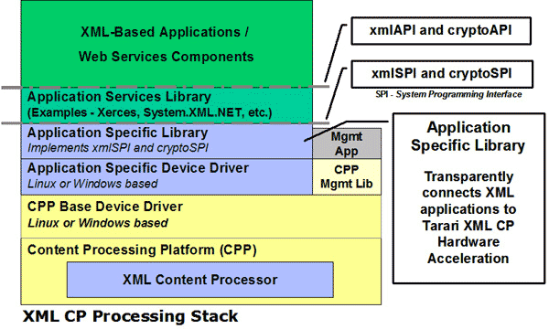
Tarari XML processor

Slide 97
Trusted computing
TC is controversial as the hardware is not only secured for its owner, but also secured against its owner
Trusted Computing proponents claim the technology will make computers safer, less prone to malware, and thus more reliable from an end-user perspective.
Opponents claim this technology will be used primarily to enforce DRM policies and not to increase computer security
Chip manufacturers Intel and AMD, hardware manufacturers such as Dell, and OS providers such as Microsoft all plan to include Trusted Computing in their next generations of products.
The US Army requires that every new small PC it purchases must come with a Trusted Platform Module(TPM).

Slide 98
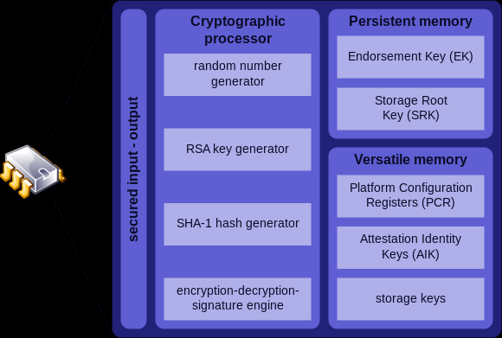
TPM structure

Slide 99
TPM functions
TPM offers facilities for the secure generation of crypto keys, and limitation of their use, in addition to a random number generator. It also includes capabilities such as:
Remote attestation – creates a nearly unforgeable hash key summary of the hardware and software configuration. The program hashing the configuration data determines the extent of the summary of the software. This allows a third party to verify that the software has not been changed.
Binding – encrypts data using TPM bind key, a unique RSA key descended from a storage key.
Sealing – encrypts data in a similar manner to binding, but in addition specifies a state in which TPM must be in order for the data to be decrypted (unsealed).

Slide 100
References
[Ame83] S.R.Ames, M. Gasser, and R.R.Schell, “Security kernel design and implementation: An introduction”, Computer, July 1983, 14-22.
[Ham73] K.J. Hammer Hodges, “A fault-tolerant multiprocessor design for real-time control”, Computer Design, December 1973, 75-81.
[Lan84] C.E. Landwehr and J.M.Carroll, “Hardware requirements for secure computer systems”, Procs. 1984 Symp. on Security and Privacy, IEEE 1984, 34-40.
[Sha02] J.S.Shapiro and N. Hardy, “EROS: A principle-driven operating system from the ground up”, IEEE Software, Jan./Feb. 2002, 26-33. See also: http://www.eros-os.org

Slide 101
References II
E.B.Fernandez and D. LaRed M., "Patterns for the secure and reliable execution of processes". Procs. of the 15th Int.Conference on Pattern Languages of Programs (PLoP 2008)
E. B. Fernandez, T. Sorgente, and M. M. Larrondo-Petrie, “Even more patterns for secure operating systems,” Procs. of the Conference on Pattern Languages of Programs, PLoP 2006, Portland, OR, October 2006, http://hillside.net/plop/2006/
E.B.Fernandez and T. Sorgente, "A pattern language for secure operating system architectures”, Proceedings of the 5th Latin American Conference on Pattern Languages of Programs, Campos do Jordao, Brazil, August 16-19, 2005, 68-88.

Slide 102
Assignment 2 (Old)
If we add layers to a microkernel we can assign servers to different layers. Indicate:
The advantages of this approach
The disadvantages of the approach
Modify the class diagram of the microkernel to include the
concept of layers.
2. Indicate the advantages and disadvantages of using public key certificates. Find three commercial systems where certificates are used to perform authentication. Give References.
3. The diagram of the Virtual Vault in slide 119 of Chapter 4 shows 4 partitions: Inside, Outside, System, and System Hi. Use a multilevel access control model for secrecy (Chapter 2) to protect the components shown in the diagram. For example, an attacker should not be able to deface the web pages or overwrite the audit trail. (Assume that the Outside partition can be compromised and prevent the attacker to harm the other partitions).

Slide 104
Authentication
Before they can perform any activities in the system both users and systems must identify themselves and be authenticated.
Identification and Authentication (I&A) use some kind of protocol to establish identity.
I&A is the basis for authorization and for logging, it provides accountability.
Once verified, the system may provide a proof of authentication and a handle (reference) to the user’s account. For example, IBM’s z/OS provides an accessor environment element (ACEE), which follows the authenticated process during its execution
Approaches for authentication can be of four types:
Something the user knows. Passwords are the most common example of this type.
Something the user has. Typically a smart card.
Something the user is. A body feature of the user, e.g. her fingerprints, is used to authenticate the user.
Where the user is. The location of the user is enough to grant him access.

Slide 105
Formally
An authentication system can be defined formally as a 5-tuple (A,C,F,L, S), where A is the information needed to prove identity, C is the information used to validate the user request, F is a complementation function f: A → C; L is a set of functions used to validate identity, and S are functions to let the user create or modify information in A or C.
The most common authentication protocol is based on passwords, some word chosen by the user that when provided to the system verifies the user. In a password system: A are the strings that correspond to the user-chosen passwords, C is the list of passwords in the system, F is the identity function {I}, L is the equality function {=}, and S is a function to set or change passwords.

Slide 106
System
legitimate
authorization
user
resources
X
X
hacker
authentication

Slide 107
Authentication hierarchy

Slide 108
Class diagram of Authenticator

Slide 109
Authenticating a user

Slide 110
Passwords
Passwords are considered a relatively weak approach. Most passwords are easy to find using a good dictionary, educated guesses, and a program that tries them in succession.
For better security the Unix password system uses slower encryption, produces less predictable passwords with a password generator, and uses ‘salting’. Salting implies that the password is encrypted using the concatenation of the time of the day and the process id as a key; the encrypted password is then concatenated with the time of the day and the process id.
The main problems with passwords are that users choose poor passwords and that they are kept for long periods of time, which means that the attacker has time to find a way to discover them. A common attack is to get a copy of the encrypted passwords (some systems don’t protect the password file itself) and perform dictionary or exhaustive attacks.

Slide 111
Password-based authentication

Slide 112
Smart cards
A card with some processing power is used to establish the connection. Smart cards use a PIN provided by the user and other information such as date, time, or name of the user to send an encrypted message to the system (typically some Authentication Server). Only if the system can decipher the message the user is connected.
The card must be tamper-resistant to prevent a person who steals the card from finding the PIN in the card. Given that these cards have a significant amount of memory there have been proposals about including in them financial, health, and employment information about their owners, although this may bring additional privacy problems.
More secure but more costly than passwords, can be lost of stolen.
Frequently used by employees of a company to connect remotely to their systems.

Slide 113
Biometrics
This is the use of some unique personal characteristic, e.g., fingerprints, retina scan, face contour, face recognition, signature dynamics. This can be a more secure approach but it is more expensive and slower than the other two.
Fingerprint recognition security has been put in doubt, people leave their fingerprints in many places and gummy fingers appear to fool most systems.
They require a large amount of data. If their digital representation is compromised they cannot be replaced.
After September 11 this approach has become considerably more popular. This popularity has also been helped by the decreasing cost of some of these approaches.

Slide 114
Multifactor authentication
For higher security we can use Multi-factor Authentication, using two of the three authentication factors: something the user has, something the user knows, and something the user is.
For example, Google can send you text messages, with a code sent to your phone (something you have) every time you log in with a password (something you know) or as most banks use for their online banking a security question that (supposedly)only you can answer(something a user knows).

Slide 115
Class diagram for Two-Factor authentication

Slide 116
Known uses
Windows Office 365--Will send a security code to your phone or your alternate email address.
Google--a code will be sent to your phone via text, voice call, or our mobile app. Or, if you have a Security Key, you can insert it into your computer’s USB port.
Bank of America--You will be asked three random questions that only you know how to answer.
Apple--You can only sign in through an approved device and your Apple Id.
Department of Defense--Uses the YubiKey along with a one time password
Others include: Wordpress, Facebook, Twitter, and DropBox.

Slide 117
Some Multi-factor authentications are weak
The IRS incident is but the latest example of a hack that could have been prevented with two-factor authentication (TFA): combining something you know (a password or PIN) with something you have (a phone or security token).
Most hacks have involved guessing weak passwords using a dictionary attack, statistical analysis, or lists of popular (and weak) passwords.
But the IRS attack exposed another flaw in common authentication schemes, reliance on personally identifiable information for access or password recovery.
The IRS attack combined a step using Name,SSN, DoB, and Filing Status with another step of personal questions selected by the taxpayers.

Slide 118
Secret questions
Although the IRS attackers appear to have gained IDs in other ways, such as purchasing a Fullz Dump, researchers atGoogle GOOGL +0.75% have discovered how easily password recovery questions can be guessed. They found answers ”contain commonly known or publicly available information, or are in a small set of possible answers for cultural reasons,” allowing the team to correctly guess challenge questions with surprising frequency. For example, there’s a one-out-of-five chance of matching an English-speaker’s favorite food (pizza) or a 12% chance of getting a Korean’s place of birth on the first try (the full research report can be found here).
Even when users attempt to spoof identity thieves it backfires. Google “found that 37% of people intentionally provide false answers to their questions thinking this will make them harder to guess. However, this ends up backfiring because people choose the same (false) answers, and actually increase the likelihood that an attacker can break in.”

Slide 119
Hackers Took Fingerprints of 5.6 Million U.S. Workers http://www.nytimes.com/2015/09/24/world/asia/hackers-took-fingerprints-of-5-6-million-us-workers-government-says.html?hp&action=click&pgtype=Homepage&module=first-column-region&region=top-news&WT.nav=top-news
WASHINGTON — Just a day before the arrival of President Xi Jinping for a meeting with President Obama that will be focused heavily on limiting cyberespionage, the Office of Personnel Management said Wednesday that the hackers who stole security dossiers from the agency also got the fingerprints of 5.6 million federal employees.
Customs and immigration officials frequently fingerprint incoming travelers; millions of fingerprints in a Chinese database would help track the true identities of Americans entering the country.
Hackers did not just get the data on federal employees, but also on job applicants, contractors and many others who have been subjected to government background checks.

Slide 120
Identity management
Authentication relies on uniquely identifying users and other entities, done by an identity management system
Users can have more than one identity, related to their roles
Each identity is defined by a set of attributes
Different identities help protect privacy and build reputation

Slide 121
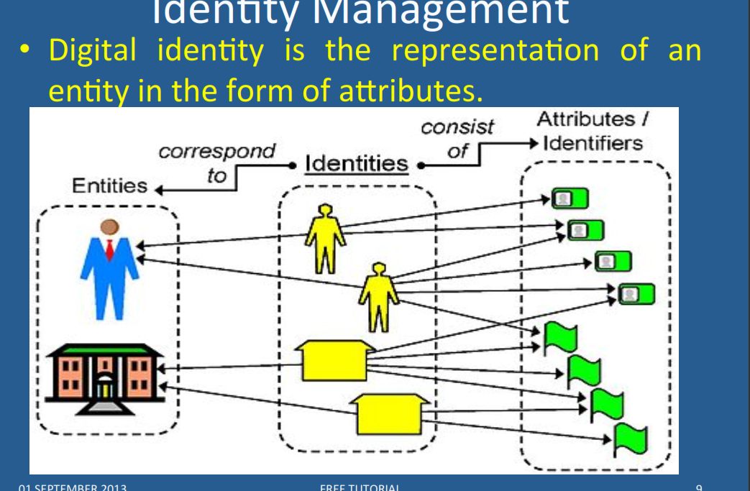

Slide 122
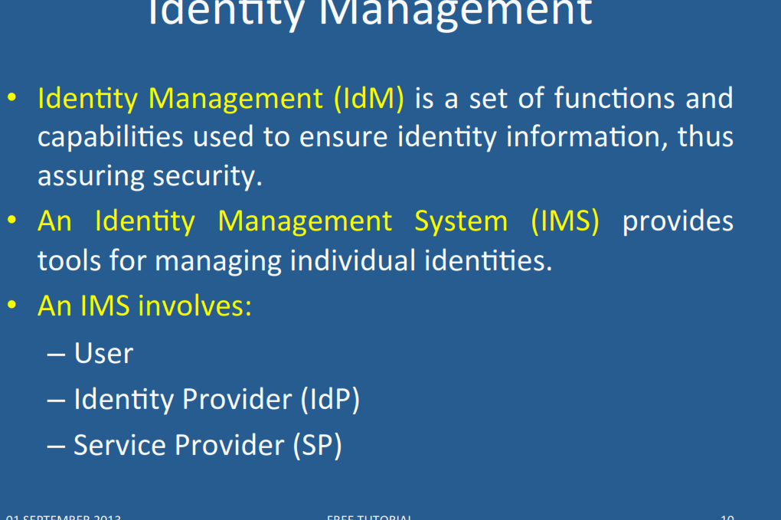

Slide 123
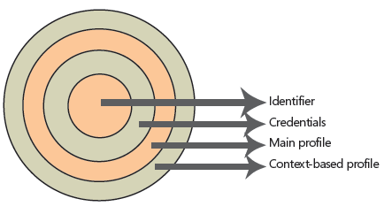
Digital identities

Slide 124
Identities
The innermost layer is the unique identifier of this digital identity. There should be no identical unique identifiers in the same security domain. Users must have unique identifiers to be easily recognizable by any system to which they have access.
To have access to this identifier, the user must present to the security system a set of credentials that will be checked against the computing secrets stored in the identity database. A user is entitled to access her own unique identifier if and only if she presents the correct set of credentials to unlock this magic number.
After the user unlocks the unique identifier, a set of common attributes (called the main profile) is accessible to a system that may require a little more knowledge than the unique identifier itself. This can be, for example, the user name, department, Social Security number, company name, and so on. These attributes do not vary from system to system; they are the same wherever the user logs on. They are a fixed set of values that are tied to the user during the lifetime of the logon session.

Slide 125
Identities II
But not all systems need to share information.
There are sets of information that are only meaningful in the context of a system or related systems. For example, frequent flier miles are meaningful only under the context of an airline carrier, losing most of its meaning if moved from one carrier to another. But they share the same semantic context when used by the mileage program associates (restaurants, hotels, credit cards, and so on). These sets of attributes are stored in the context-based profile.
One digital identity can have only one unique identifier, a limited set of credentials (username/password pair, digital certificate/pin number pair, biometrical data), a unique set of main profile attributes, and an unlimited set of context-based profile attributes.

Slide 126
Identity management patterns

Slide 127
Circle of Trust
The Circle of Trust pattern allows the formation of trust relationships among service providers in order for their subjects to access an integrated and more secure environment.
Context: Service providers that provide services to consumers (subjects) over large systems such as the Internet.

Slide 128
Circle of trust class diagram

Slide 129
Identity Provider
The Identity Provider pattern allows the centralization of the administration of subjects’ identity information for a security domain.
Context: One or several resources, such as web services, CORBA services, applications, etc, that are accessed by a determined set of subjects. The subjects and resources are typically from the same organization.
Problem: Each application, or service may implement its own code for managing subjects’ identity information, leading to an overload in implementation and maintenance costs and that may lead to inconsistencies across the organization’s units.

Slide 130
Identity Provider class diagram

Slide 131
Identity Federation
The Identity Federation pattern allows the formation of a dynamically created identity within an identity federation consisting of several service providers. Therefore, identity and security information about a subject can be transmitted in a transparent way for the user among service providers from different security domains.
Problem: There may be no relationship among some of the security domains accessed by a Subject. Thus subjects may have multiple unrelated identities within each security domain. Consequently, they may experience multiple cumbersome registrations, authentications and other identity-related tasks prior to accessing the services they need.

Slide 132
Identity Federation

Slide 133
Identity Federation

Slide 134
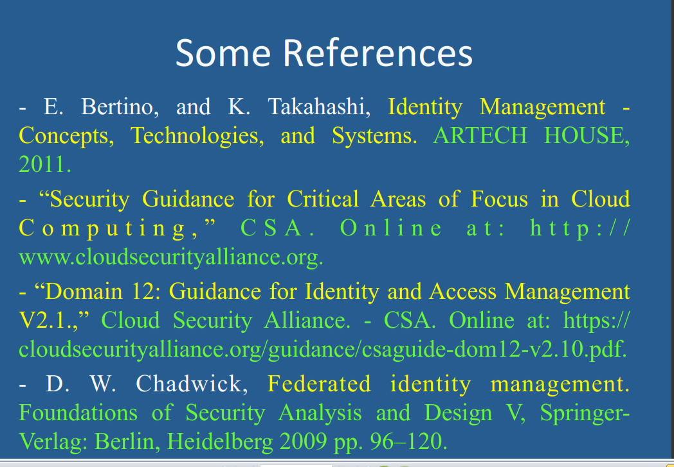

Slide 135
References for Identity
N. Delessy, E.B.Fernandez, and M.M. Larrondo-Petrie, "A pattern language for identity management", Procs. of the 2nd IEEE Int. Multiconference on Computing in the Global Information Technology (ICCGI 2007), March 4-9, Guadeloupe, French Caribbean.
http://www.computer.org/portal/web/csdl/doi/10.1109/ICCGI.2007.5
E.B.Fernandez, “Security patterns in practice: Building secure architectures using software patterns”, Wiley Series on Software Design Patterns, 2013. Chapter4: Identity Management
J. Rodriguez and J. Klug, “Federated identity patterns in a service-oriented world”, Microsoft Architecture Journal, 16, 6-11.
SOA Patterns, “Federated identity”, http://soapatterns.org/federated_identity.php

